Slide 1
INTRO TO Mentors
GIRLSCRIPT EDUCATION OUTREACH PROGRAM

Slide 2
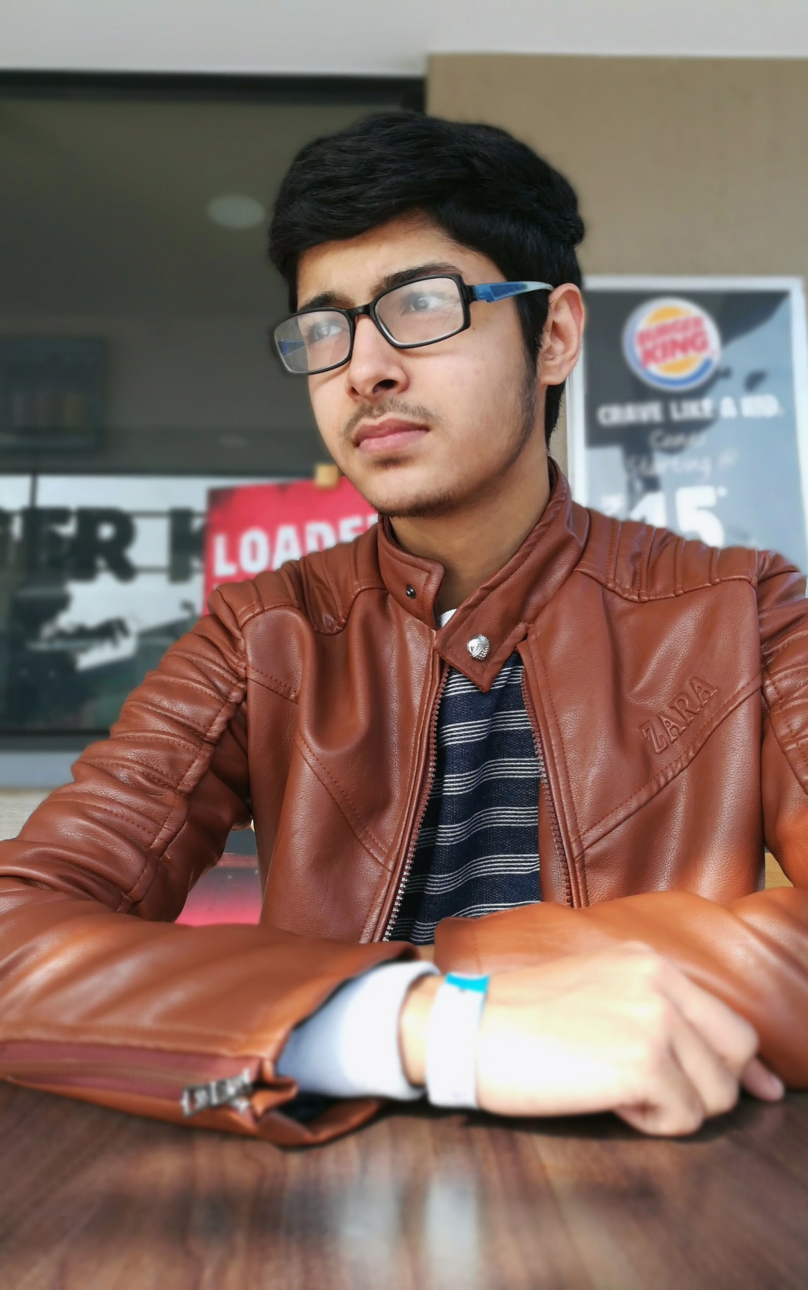


Hello!
I am Saurabh Chauhan
Pre-final year @ MAIT , Delhi
MERN stack developer , Devops Enthusiast
Like playing multiplayers when not coding.
You can connect me via below platforms

Slide 3
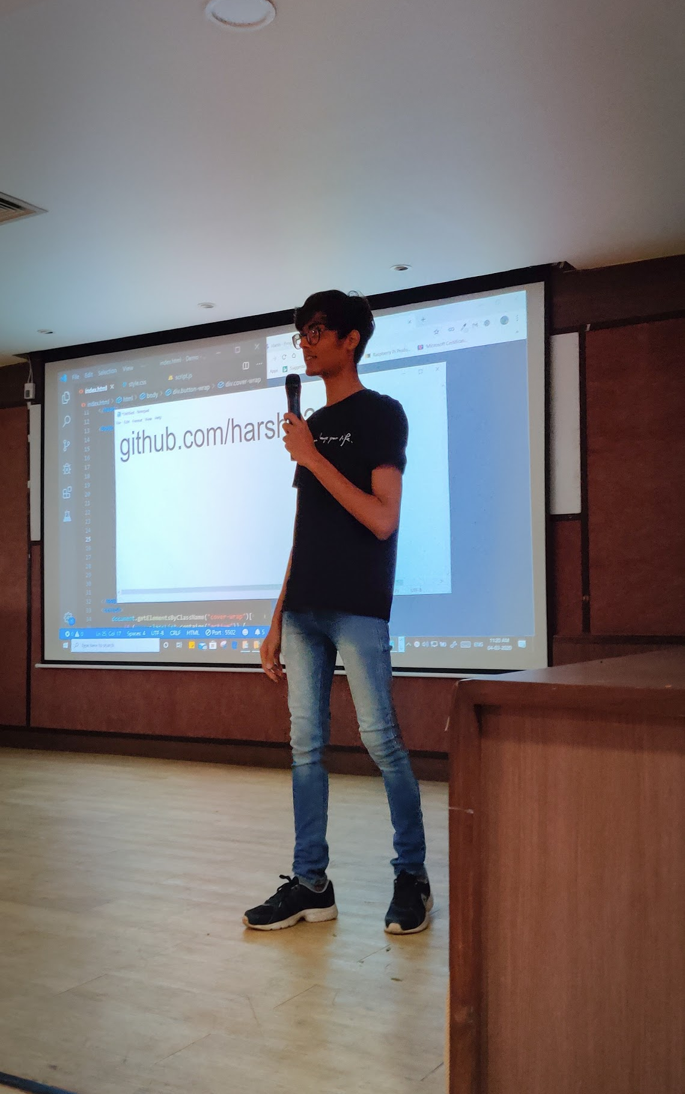




Hello!
I am Harsh Jobanputra
I have 2 years experience in React Native and React JS.
You can connect me via below platforms

Slide 4
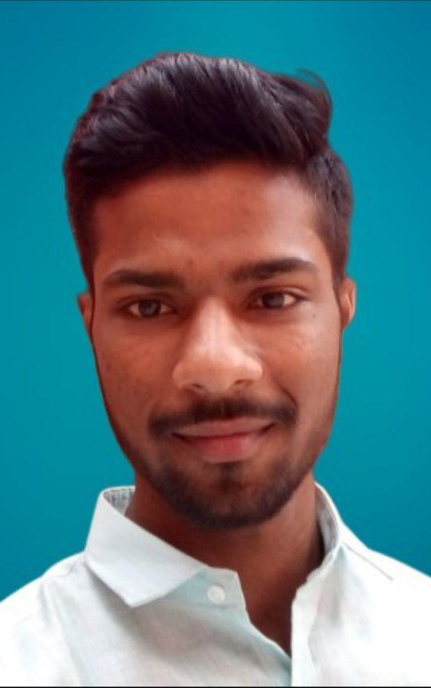
Hello!
I am Yogesh Jakhar
I have 3 years of experience in web development and one year in JavaScript in Angular8.
You can connect me via below platforms

Slide 5
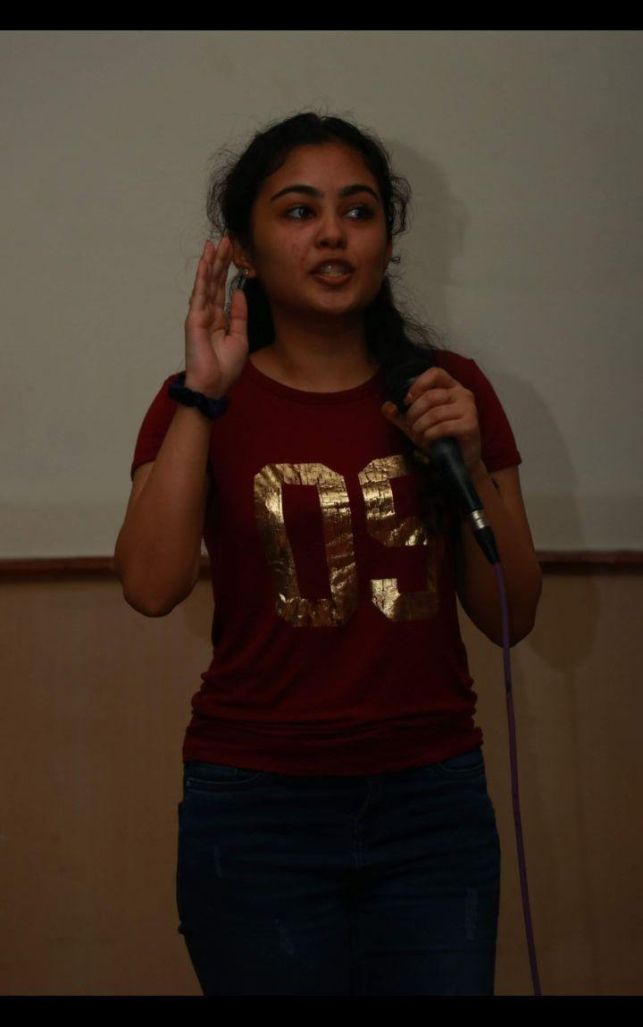

Hello!
I am Tanisha Sabherwal
A person who likes Front-end development, Design and Inclusion with everything at its intersection. Going strong on community engagements and public speaking. Other than that I draw cool stuff.
You can connect me via below platforms

Slide 6
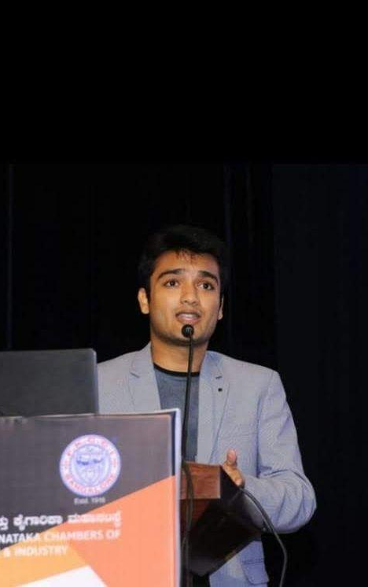

Hello!
I am Shubham Goyal
A budding entrepreneur and Fullstack Developer.Skilled in Project Initiation, Strategic Planning, Public Speaking and love sharing my knowledge and working in groups.
You can connect me via below platforms

Slide 7
Check details for the course
Course outline : Check here
Detailed course: Check here

